Slide 1
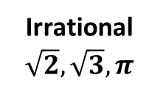
Number Type Ordering
Real
Rational 1/3, 1/5
Integer -1, -2, -3
Whole (zero)
Irrational
$$\sqrt{2},\sqrt{3}, π$$
Natural (Counting)
1, 2, 3

Slide 2
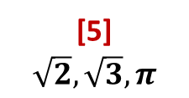
Number Type Ordering
[6]
[4] 1/3, 1/5
[3] -1, -2, -3
[2] (zero)
[5]
$$\sqrt{2},\sqrt{3}, π$$
[1] (Counting)
1, 2, 3

Slide 3
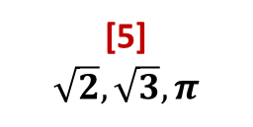
Number Type Classification
[6]
[4] 1/3, 1/5
[3] -1, -2, -3
[2] (zero)
[5]
$$\sqrt{2},\sqrt{3}, π$$
[1]
(Counting)
1, 2, 3

Slide 4
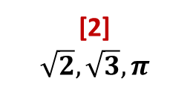
Number Type Classification (Reverse)
[1]
[3] 1/3, 1/5
[4] -1, -2, -3
[5] (zero)
[2]
$$\sqrt{2},\sqrt{3}, π$$
[6]
(Counting)
1, 2, 3

